Slide 1
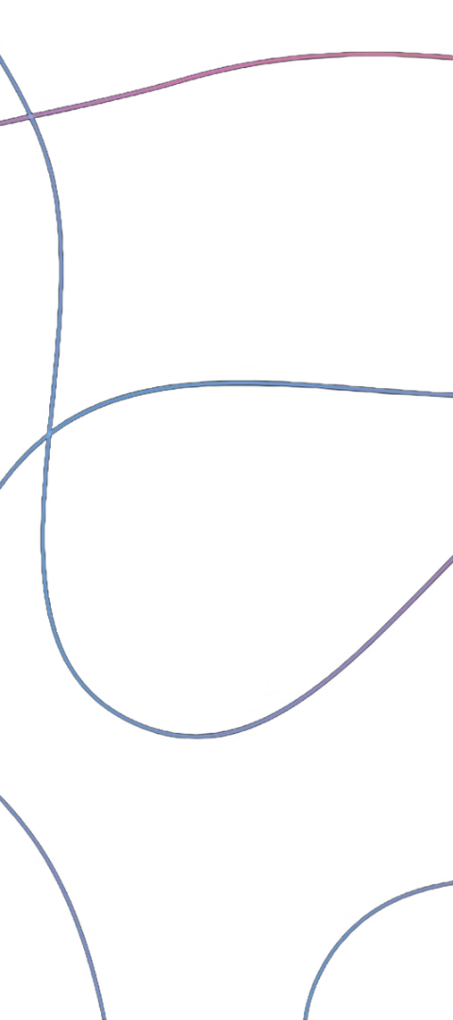


Histograms: Visualizing Data Distribution
Histograms are a powerful data visualization tool used to understand the distribution of numerical data. They divide the data into intervals and display the frequency of data points within each interval as bars, providing a clear and intuitive representation of the data.
by Karthik M S

Slide 2
Dividing Data into Intervals
Bin Size
Frequency Counts
Bar Width
Histograms divide the data range into equal-sized bins or intervals, known as bins. The bin size can be adjusted to provide the best representation of the data.
The height of each bar in the histogram corresponds to the frequency or count of data points that fall within that bin or interval.
The width of the bars represents the size of the bin, while the height indicates the frequency of data points in that bin.

Slide 3
Understanding the Shape of the Distribution
Symmetrical
1
A symmetrical histogram indicates a normal or bell-shaped distribution, where the data is evenly distributed around the mean.
2
Skewed
Skewed histograms, where the distribution is not symmetrical, can indicate the presence of outliers or uneven data distribution.
Multimodal
3
A histogram with multiple peaks suggests the presence of multiple distinct subgroups or modes within the data.

Slide 4
Identifying Central Tendency and Spread
Central Tendency
Data Spread
Outliers
Histograms can help identify the central tendency of the data, such as the mean, median, and mode, which are important measures of the data's central location.
The histogram's shape and the distribution of the bars can provide insights into the spread or variability of the data, such as standard deviation and range.
Histograms can also help detect outliers, or data points that are significantly different from the rest of the distribution, which may indicate errors or anomalies.

Slide 5




Limitations and Considerations
Bin Size
Sample Size
Data Scale
Data Type
The choice of bin size can significantly affect the appearance and interpretation of the histogram, so it's important to experiment with different bin sizes.
Histograms work best with large data sets, as small sample sizes may not provide an accurate representation of the true data distribution.
Histograms are sensitive to the scale of the data, so it's important to ensure the data is appropriately scaled before creating the visualization.
While histograms are primarily used for numerical data, they can also be applied to categorical data by encoding the categories as numerical values.

Slide 6
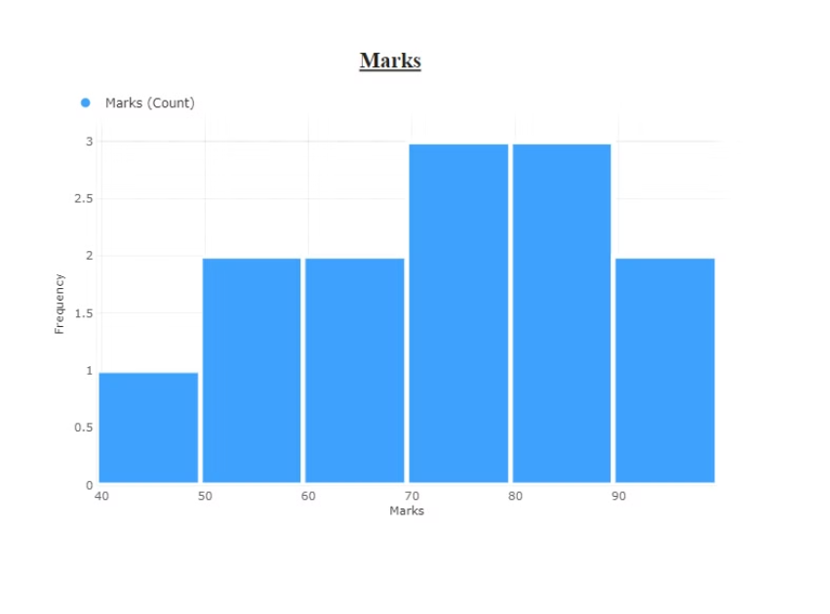
Histogram created using Power Bi
The histogram shows the frequency distribution of marks. The marks range from 40 to 90 in 10-point intervals. The most frequent scores are in the 70-80 range, with 3 occurrences each. The frequencies decrease towards the lower and higher ends, suggesting fewer very low or high marks. The distribution appears somewhat symmetrical, with a slight skew towards higher marks.

